Slide 1
Introduction to ESIPAP Computing Sessions
Wednesday 8 – Thursday 9 February 2023
ERIC CHABERT - ERIC CONTE

Slide 2

Goals of the computing sessions
Computing is required for instrumentation purposes:
Simulation of sensor
Data acquisition
Data analysis
Algorithm and reconstruction of physics objects
Computing sessions target to apply your theoretical knowledge:
Instrumentation
Software programming in C++
Using specific tools of high energy physics: ROOT
Working by yourself and experimenting
Getting the good practice

Slide 3
Physics Context

Slide 4
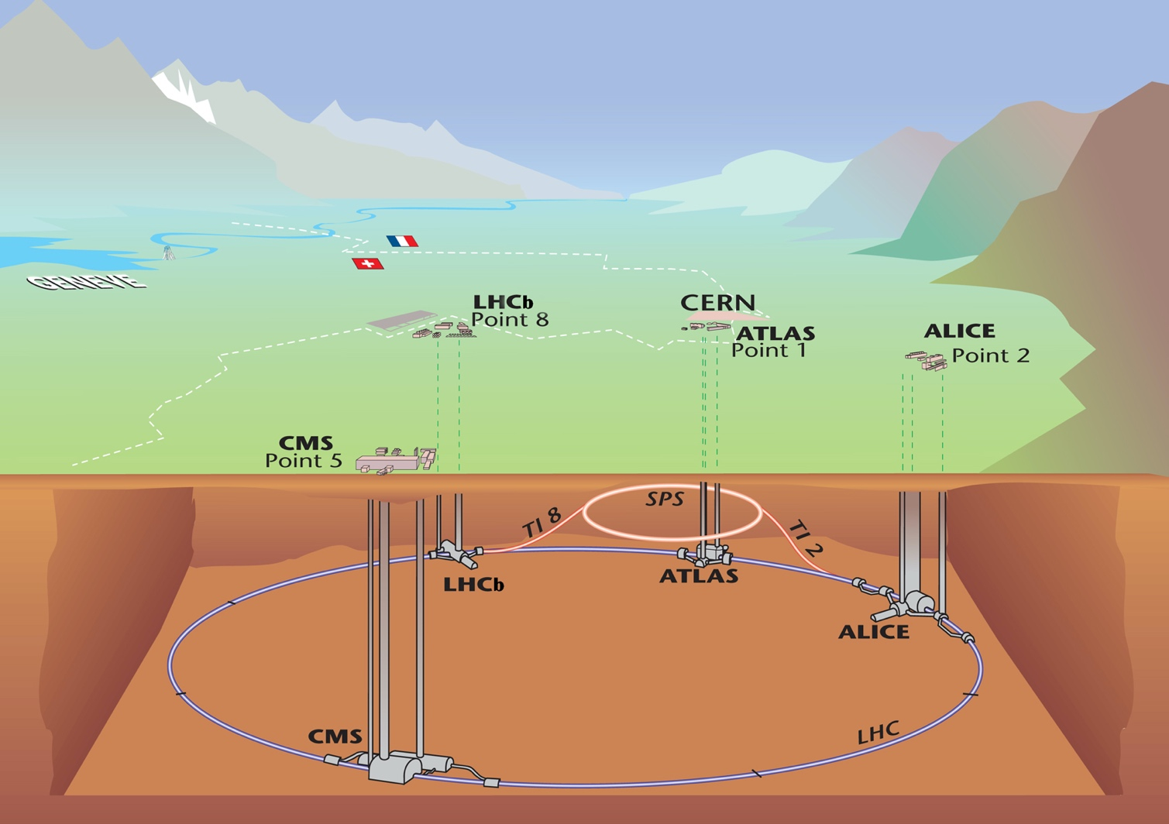
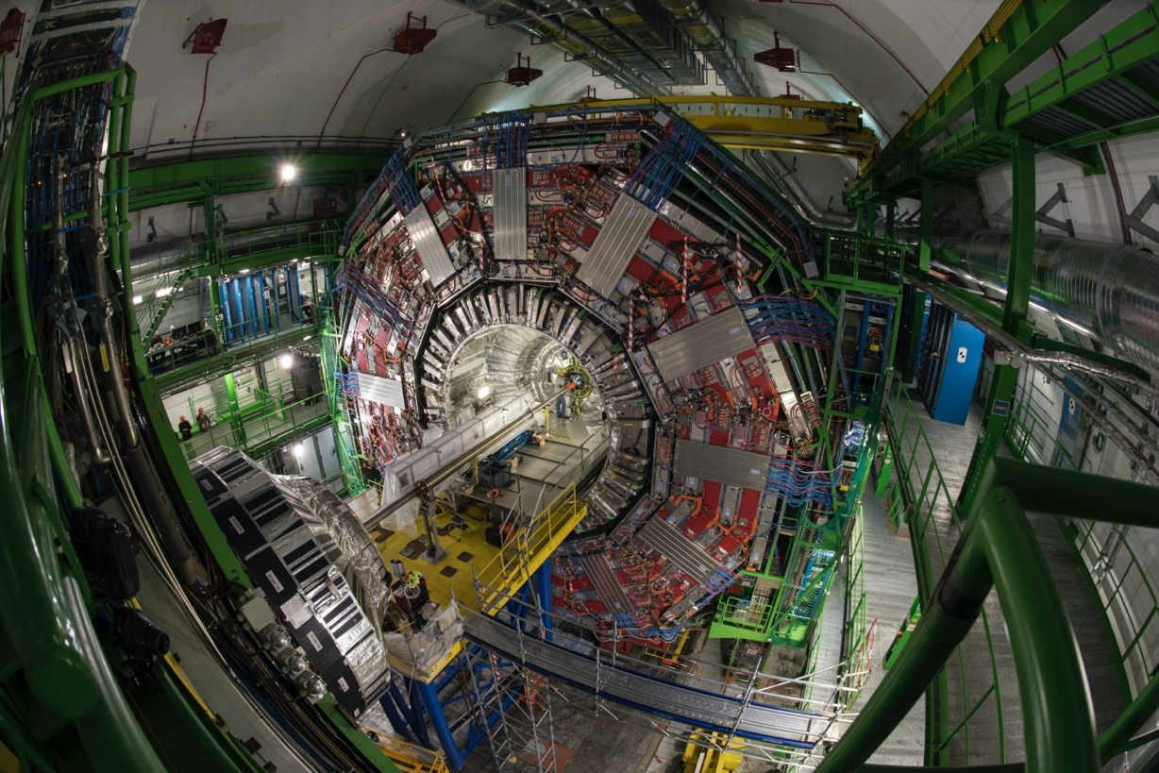
The CMS (Compact Muon solenoid) detector

Slide 5
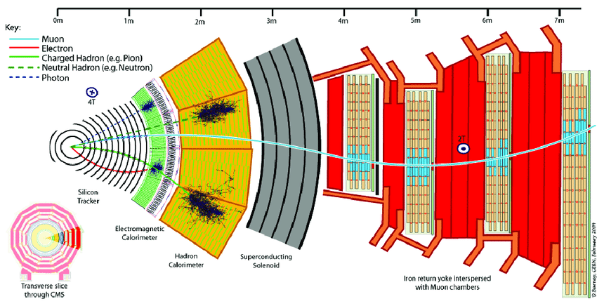
The CMS (Compact Muon solenoid) detector

Slide 6

Silicon strip tracker

Slide 7
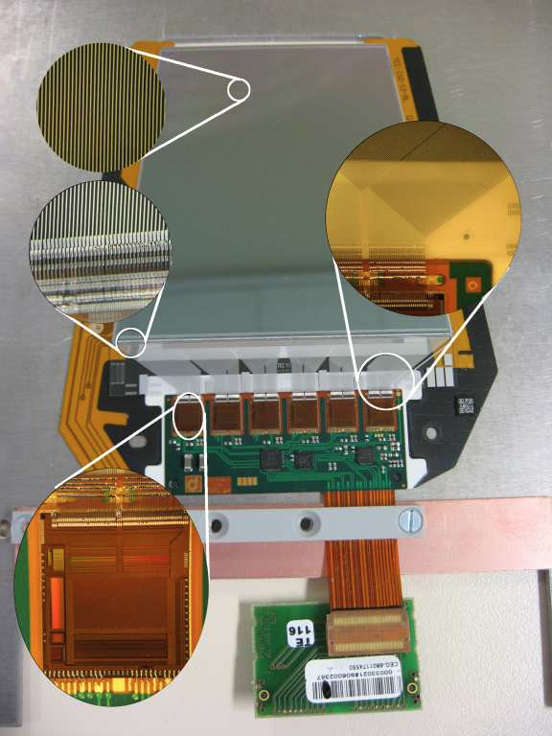

Silicon strip tracker
CMS silicon strip tracker in few numbers:
15 000 modules
Surface: ~ 200 m²
10⁶ channels
Instrumental activities
R&D
Construction
Operation (online)
Alignment & calibration
Offline analyses
Simulation
Radiation damages evaluation
…
Performances:
Hit resolution: 20-40 μm
Hit efficiency > 98% (at high Pile-Up)
Timing alignment accuracy: 1ns
…

Slide 8
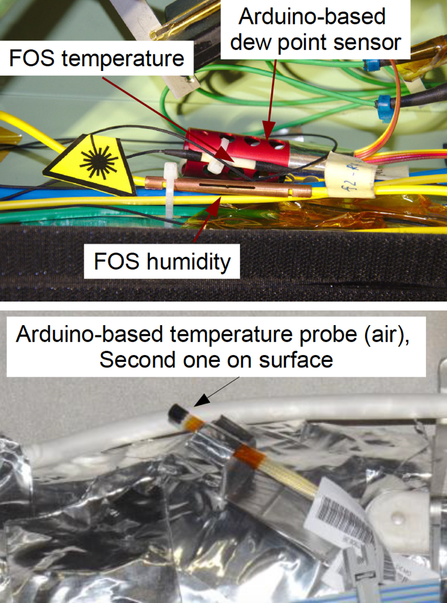
Silicon strip tracker
During its operation it is important to monitor environment conditions:
Temperature
Leakage current
Noise
Thermal dissipation
Radiation damages
…
Humidity
Dew points & condensation
Front End electronics
…
Monitoring tools
Several probes are used to monitor that:
On-board sensors
External sensors
Some are Arduino-based!

Slide 9
Computing session aims
Slow control
Using a dedicated electronic board (Sense Hat) read by a Raspberry
Monitor the temperature & humidity
Send warning when conditions are not fulfilled
Offline analyses
Calibration of the temperature sensors
Evaluation of the sensor resolution
3. Simulation
Basic simulation with the Geant4 package of a CMS silicon strip sensor
Instrumental activities
R&D
Construction
Operation (online)
Alignment & calibration
Offline analyses
Simulation
Radiation damages evaluation
…

Slide 10
SETUP

Slide 11
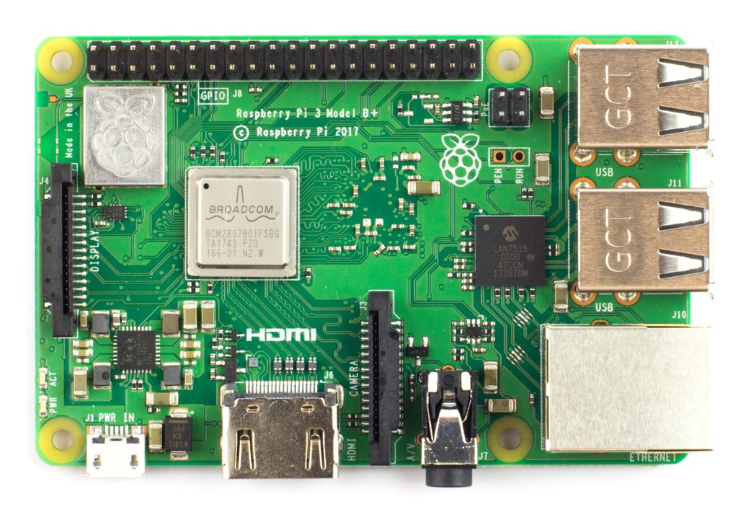
The Raspberry board
Raspberry Pi 3 B+ motherboard
Quad-core 64 bits processors @ 1,4 GHz
ARM (Acorn Risc Machine) architecture used mainly in smartphones, tablets, robotics, automation Advantages : price, flexibility, performances

Slide 12
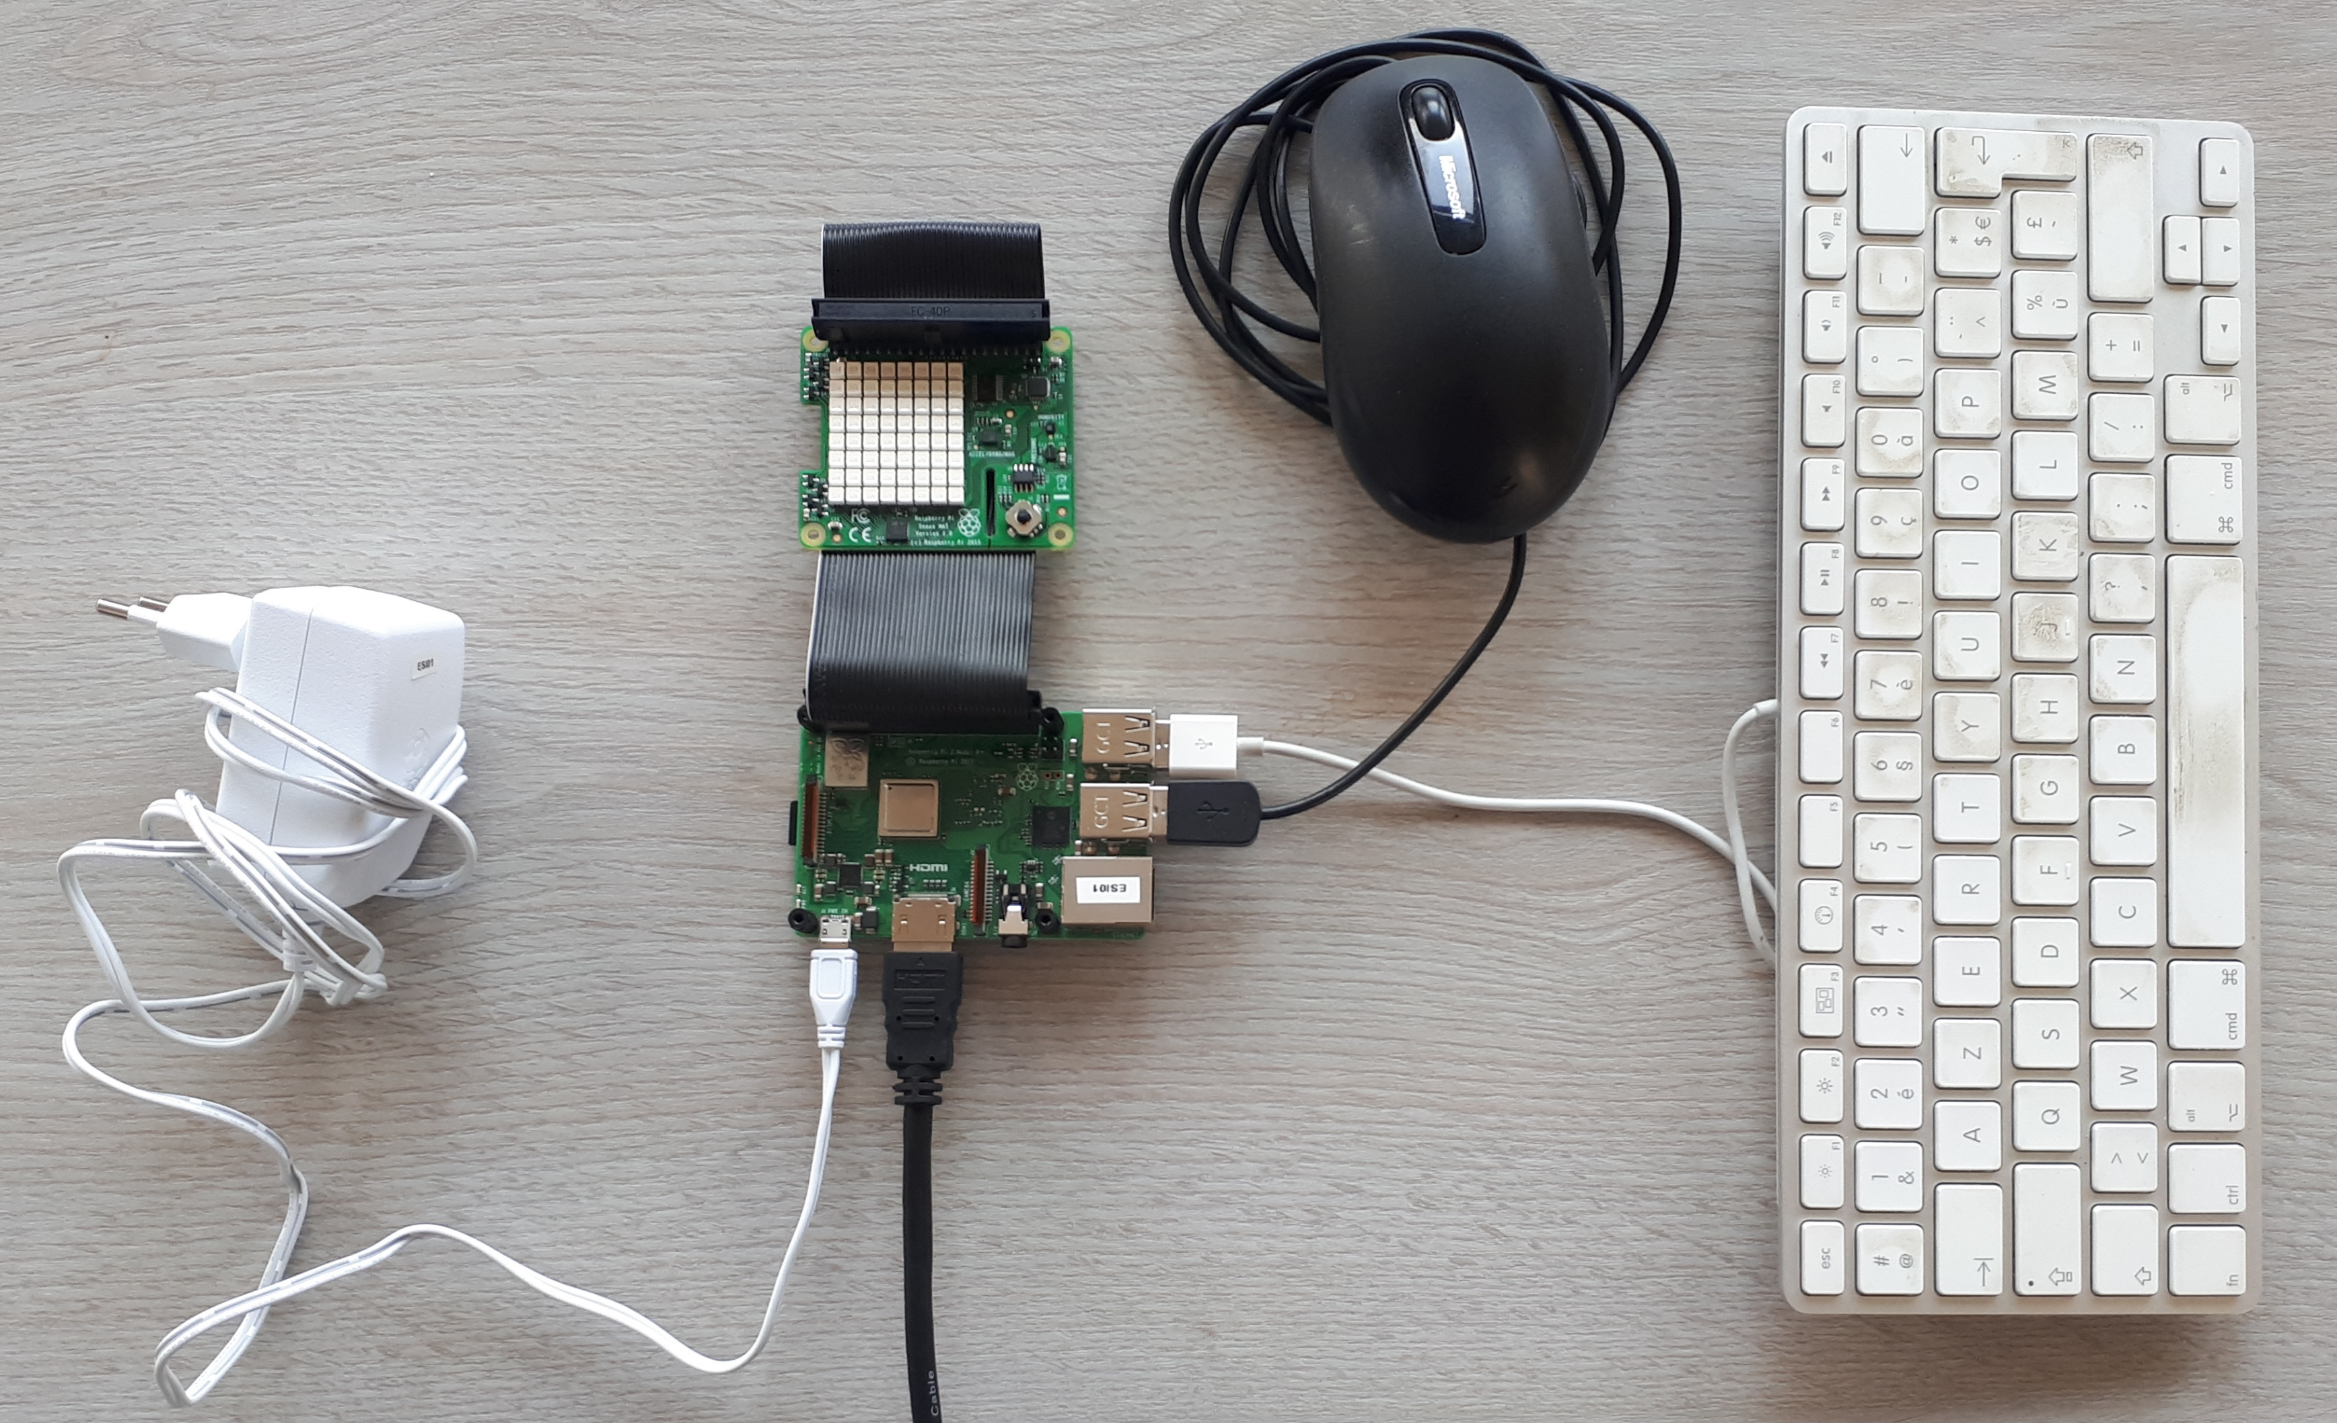
Connections to peripherical devices
4 USB ports
1 ethernet port
1 HDMI plug
1 GPIO (General Purpose Input/Output) port for connecting sensors
Powered by micro USB (5V, 2.5A min)
+ WIFI
+ Bluetooth

Slide 13
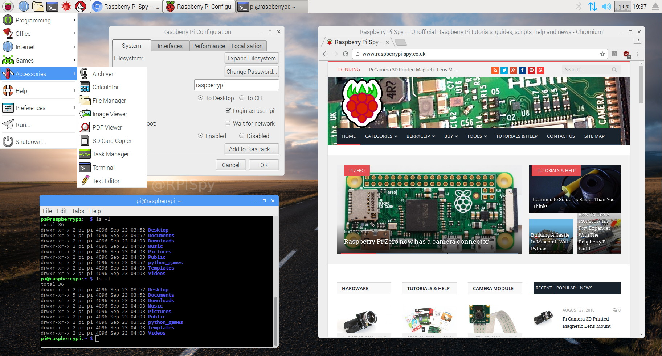
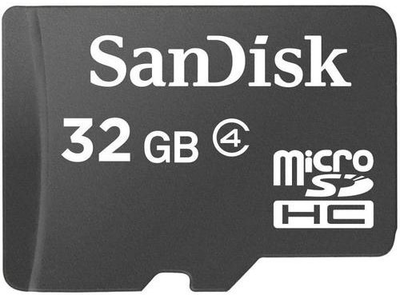
Linux distribution: Raspberry Pi OS (previously Raspbian)
Stored on a micro SD card

Slide 14
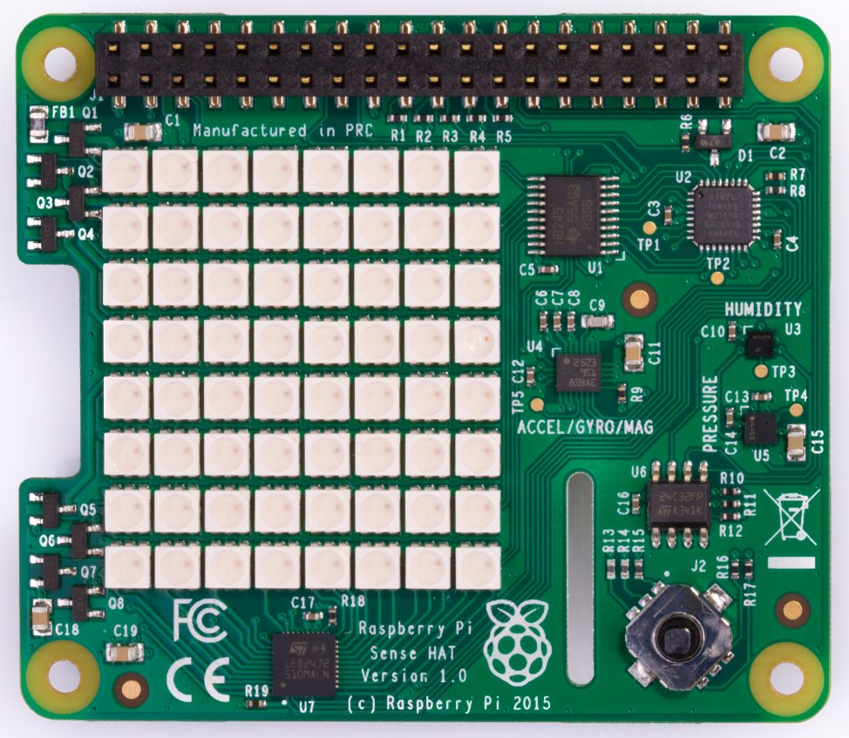
Sense Hat board
3D accelerometer, 3D gyrometer and 3D magnetometer sensor
8x8 LEDs for display
Humidity / Temperature
sensor
Pressure / Temperature
sensor
Joystick

Slide 15
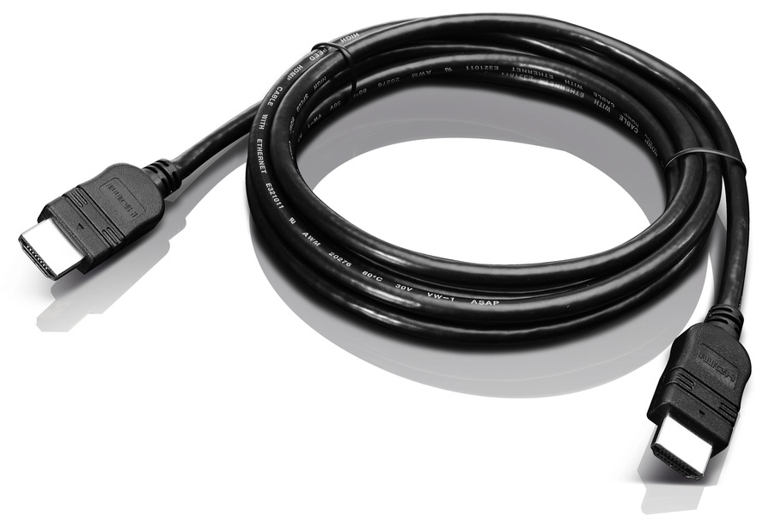
Price
Raspberry Pi 3 B+
~ 40 €
Sense Hat
~ 30 €
Total: ~ 100€
(good gift for Saint-Valentin’s day)
Connectors
~ 15 €
Micro SD
~ 10 €

Slide 16
Sensors and signal Conditioning

Slide 17
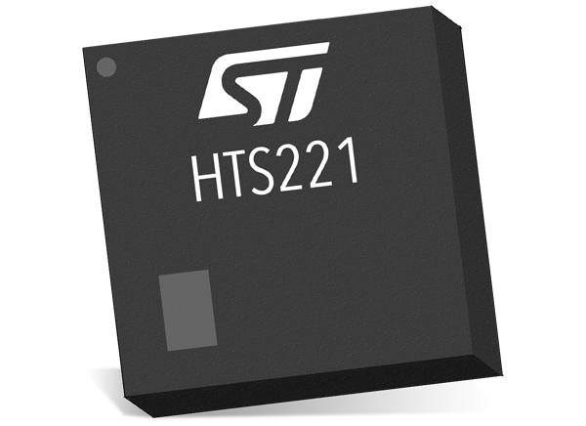
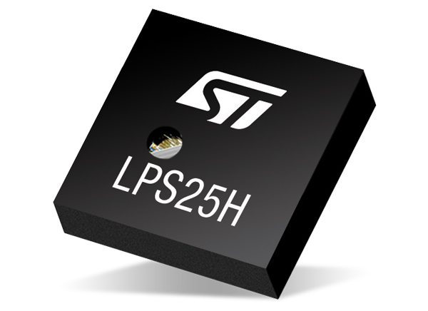
Sensors to study
Humidity / Temperature
sensor
Pressure / Temperature
sensor

Slide 18
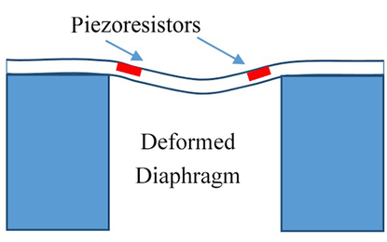
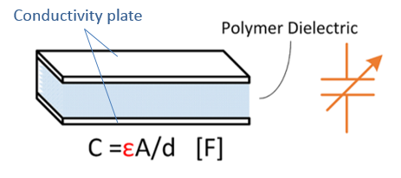


How to measure ….?
Temperature
Pressure
Humidity
L
S
R$=ρ\frac{S}{L}$
Dielectric material absorbs water molecules until equilibrium
change the electrical conductivity ε [in S/m]
Material resistivity $ρ$ depends on temperature.
Piezoresistive effect:
a change in resistivity when a stress is applied.

Slide 19
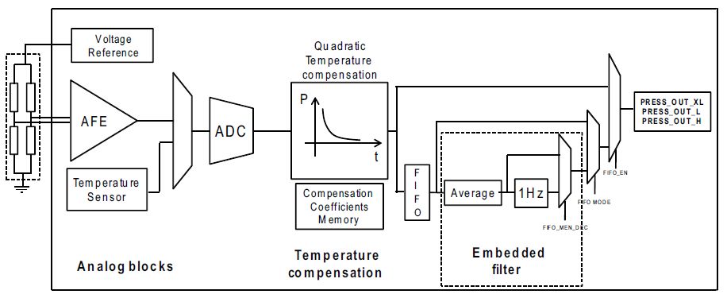
Pressure / temperature sensor process

Slide 20
Pressure / temperature sensor process
Wheatstone bridge
for translating change of resitance into change of tension

Slide 21
Pressure / temperature sensor process
Analogic Front-End
Small signal voltages vs noise floor
Amplifying signal and removing noise

Slide 22
Pressure / temperature sensor process
Multiplexer
Treating pressure and temperature measures by the same channel

Slide 23
Pressure / temperature sensor process
Analogic to Digital converter
Digitalization of the measure

Slide 24
Pressure / temperature sensor process
Temperature compensation
Piezoresistivity depends on T
→ Need to compensate this effect
Calibration settings

Slide 25
Pressure / temperature sensor process
Average
A maximum of 32 successive measurements are done (~1s) and an average value is computed.
Calibration settings

Slide 26
Pressure / temperature sensor process
Data transfer
Data are sent to the Raspberry via the GPIO port with the protocol I2C

Slide 27
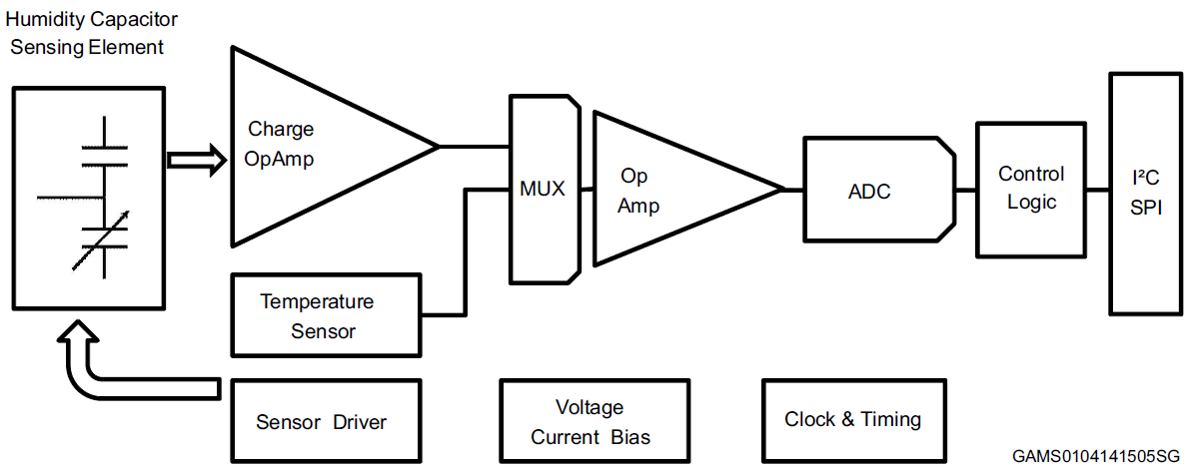
Humidity / temperature sensor process
One logic part is missing in this schema:
Translation of the tension to temperature and relative humidity.
Calibration settings

Slide 28
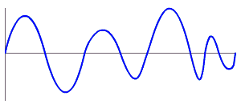
ADC resolution for temperature sensor
ADC 24 bits
0 | 1 | 0 | 1 | 1 | 1 | 0 | 1 | 0 | 0
analogic
digital
Operating range of the sensor: [260 hPa to 1260 hPa] where the sensor is relevant and reliable
Conversion pressure to measure: measure = pressure × 4096
Number of bits for coding the maximum value 1260 hPa → measure = 5 160 960 → N = 23 bits because 2²²-1 < measure < 2²³-1 …. but not standard: using 24 bits – ADC
Full range : [ 0 hPa to 4096 hPa]
Sensitivity : 4096 hPa / 2²⁴-1 = 0,00024 hPa

Slide 29
Summary on ADC sensitivity
 | Pressure - Temperature sensor |  | Humidity - Temperature sensor
 | Pressure | Temperature | Humidity | Temperature
Operating range | 260 hPa to 1260 hPa | -30°C to +105°C | 0% to 100% | -40°C to +120°C
Full scale | 0 hPa to 4096 hPa | -30°C to +110°C | Linear interpolation, depending of the calibration coefficients
ADC resolution | 24 bits | 16 bits | 16 bits | 16 bits
Sensitivity | 0,00024 hPa | 0,002 °C | 0,004 % | 0,016 °C

Slide 30
Organization

Slide 31
Organization in sessions
9:00
12:15
14:00
17:15
Session 1
Session 2
Wednesday
Introduction
Data acquisition
Developing a C++ class
Session 3
Session 4
Thursday
Combining classes
Analyzing data with ROOT

Slide 32


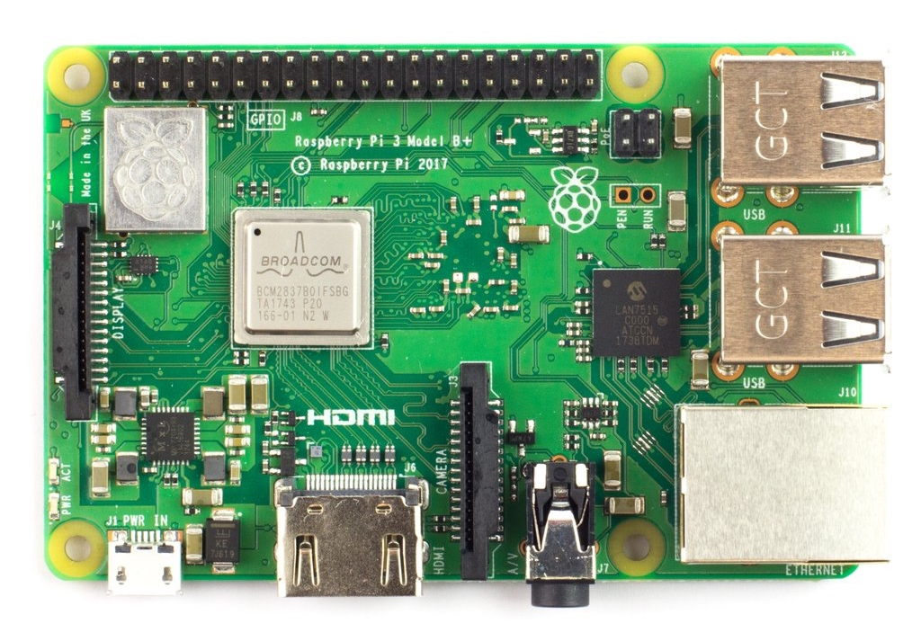


Multi-plaTform development
Windows
Linux
Mac OS X
Raspberry board (ARM architecture)

Slide 33





Tools to USE
Saving and preserving code on the internet: site github
Sharing codes with others.
Generating automatically documentation of your code (in HTML and LaTex)
Building a C++ project witch several files
(Linux / MacOSX only)

Slide 34
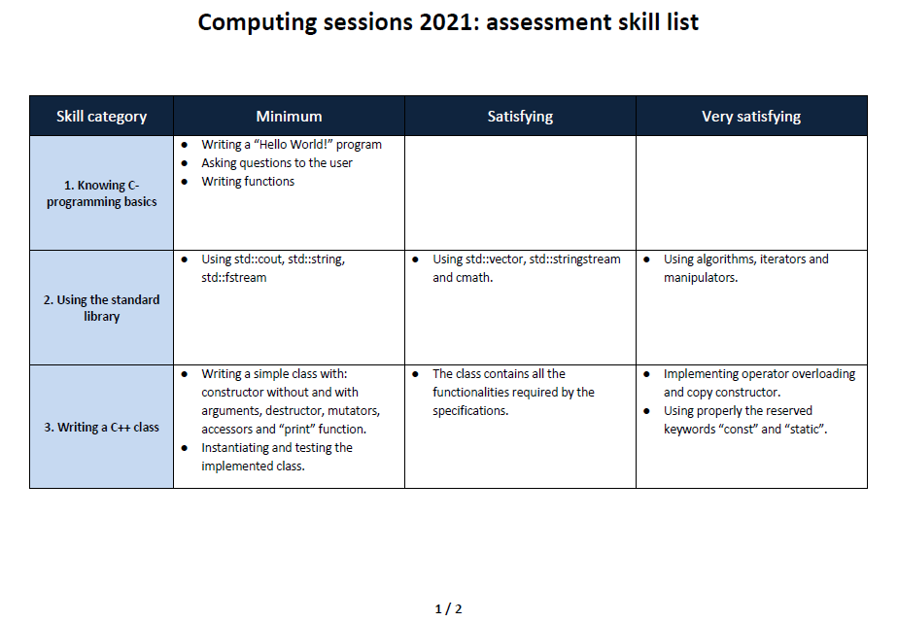
Skill assessment
Computing sessions 2023: assessment skill list
Individual work is required
Evaluation over 8 categories
For validating the module
Minimum level must be reached for all the 8 categories
Satisfying level for at least 4 categories

Slide 35
Booting / Turning off your raspberry

Slide 36
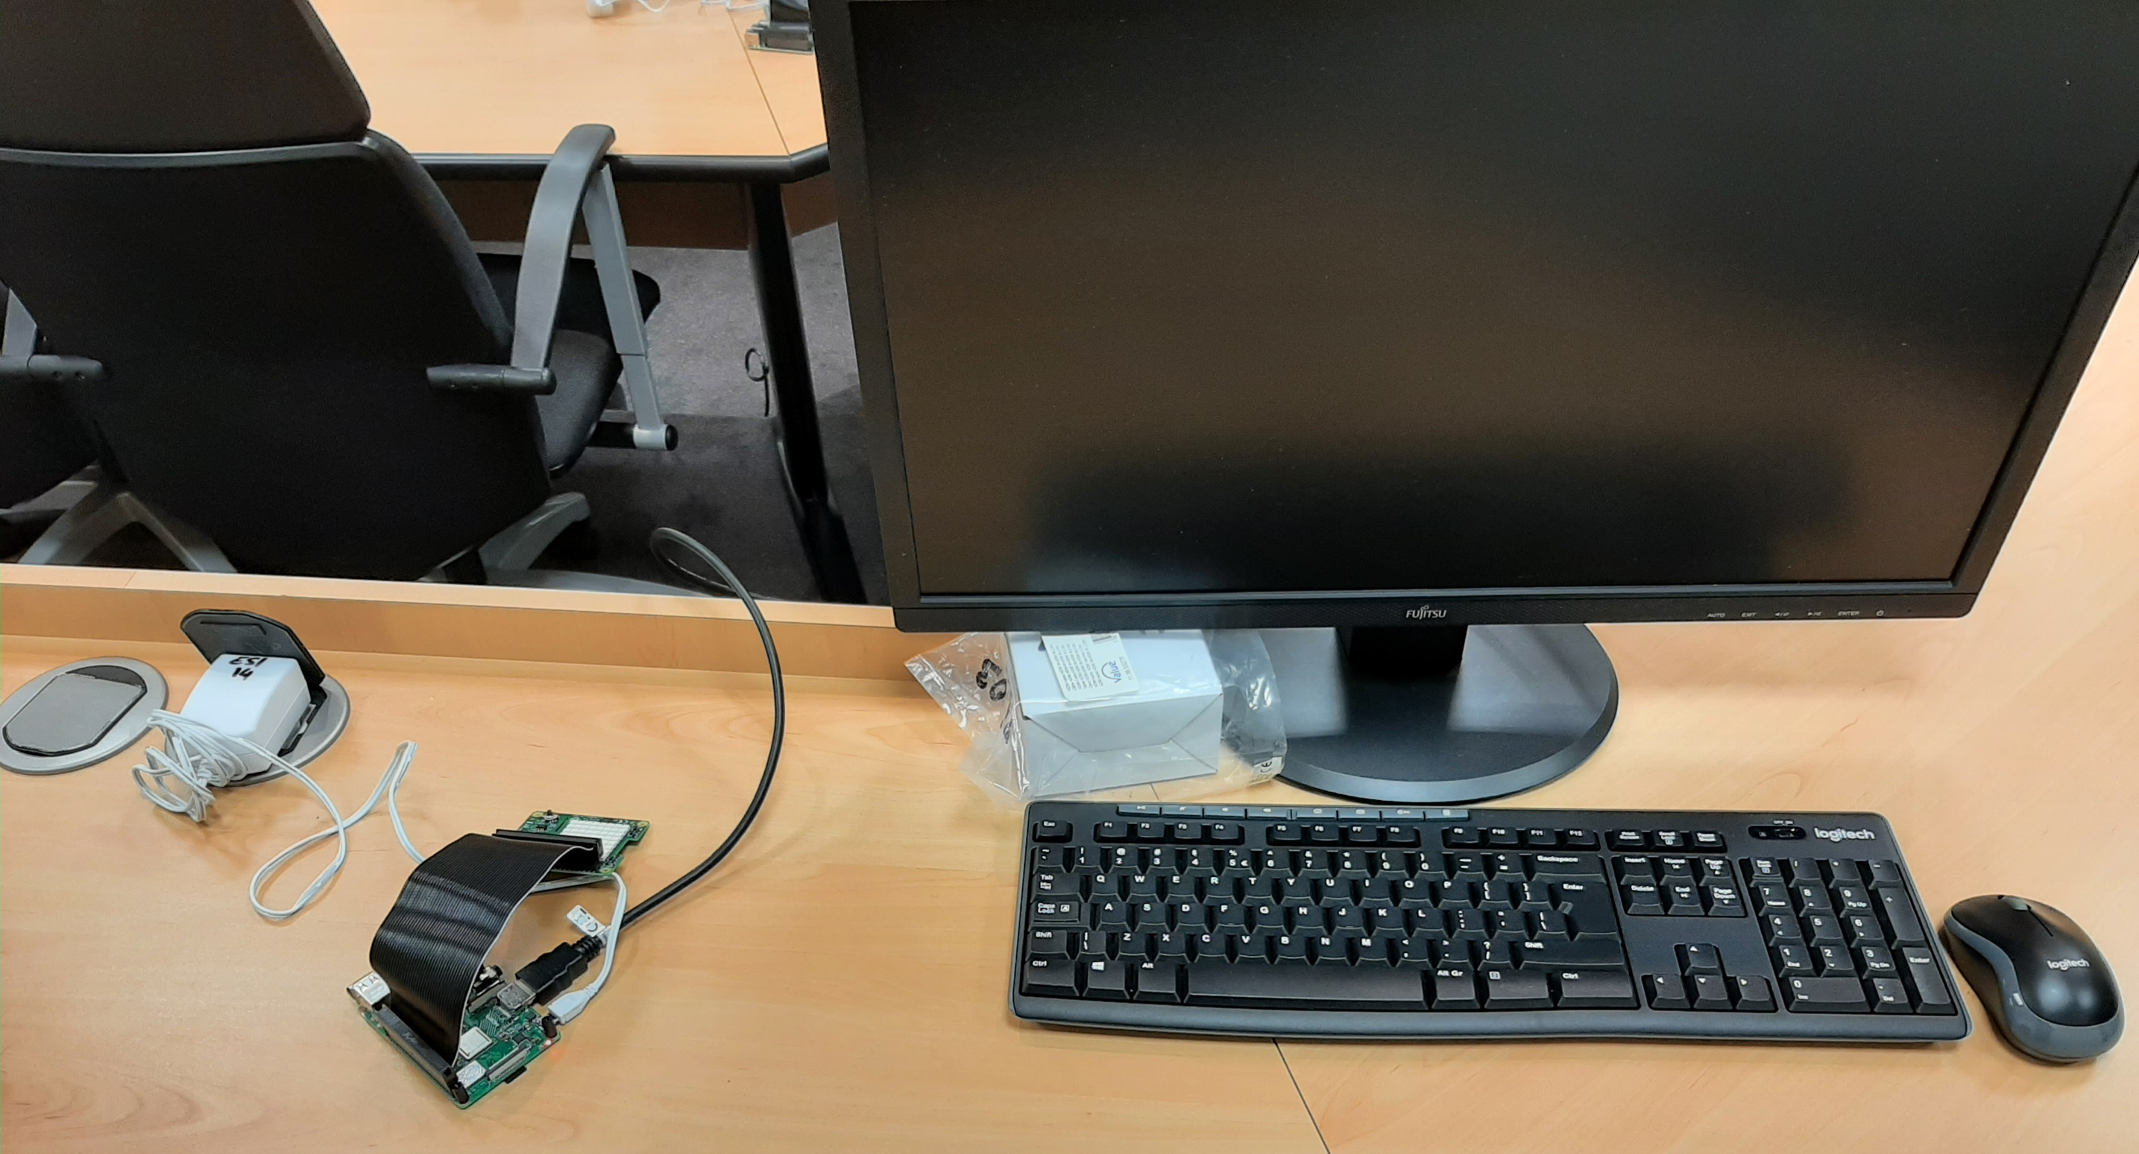
Boot
1. Connecting the power supply
2. Switching on the keyboard and mouse

Slide 37
shutdown
1. Shutdown properly the Linux distribution
2. Wait that the green LED turns off
4. Switch off the keyboard and mouse
3. Withdraw the power supply

